Slide 1

Population change in Czechia
Lukáš Hofman
Czech Statistical Office

Slide 2
Getting and loading the data
Created own database at https://vdb.czso.cz/vdbvo2/faces/cs/index.jsf?page=uziv-dotaz#
Focuses on population changes on trends that affect population change:
Population change, deaths, births
Age of mothers, Abortions, Mortality rate
XML files

Slide 3
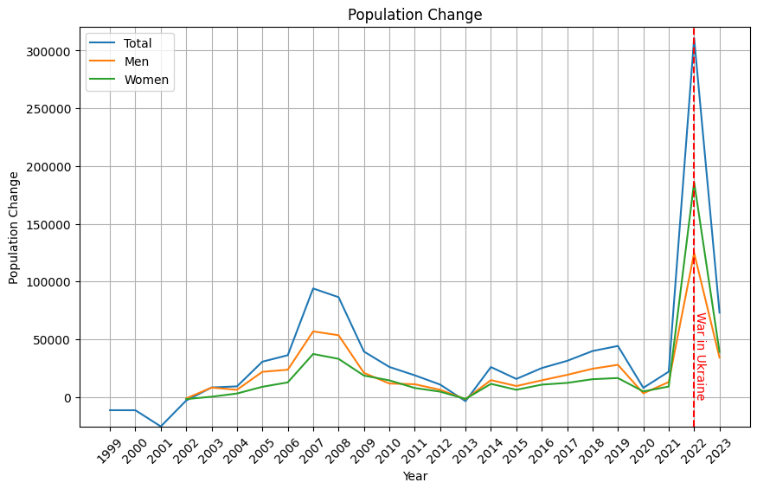
Overall population change

Slide 4
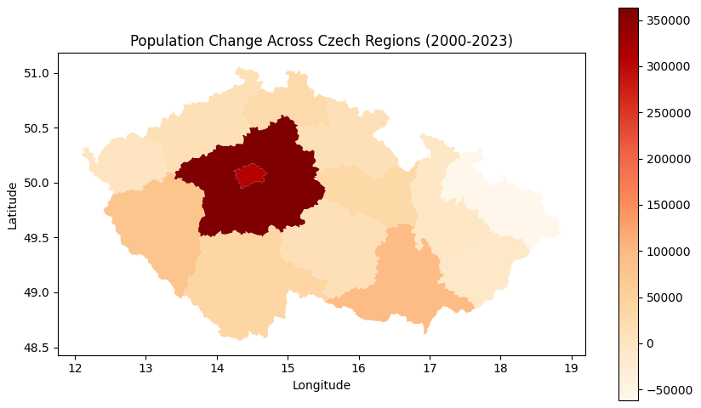
Population change in regions

Slide 5
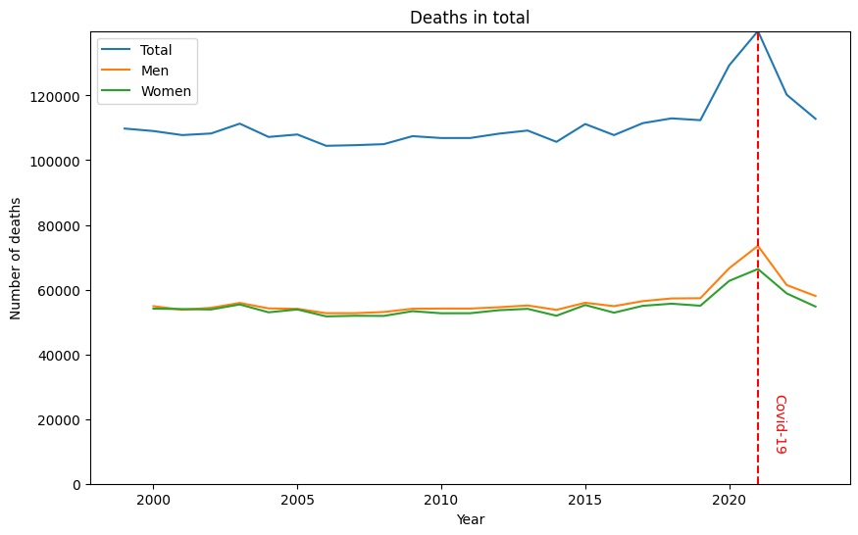
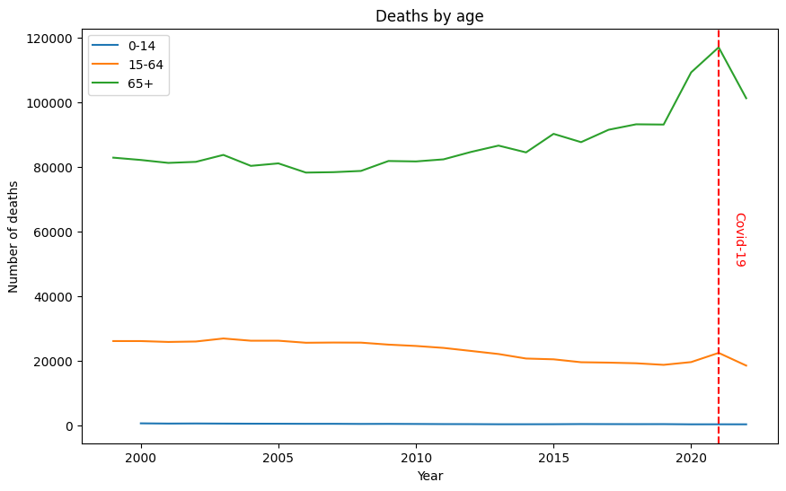
Deaths

Slide 6
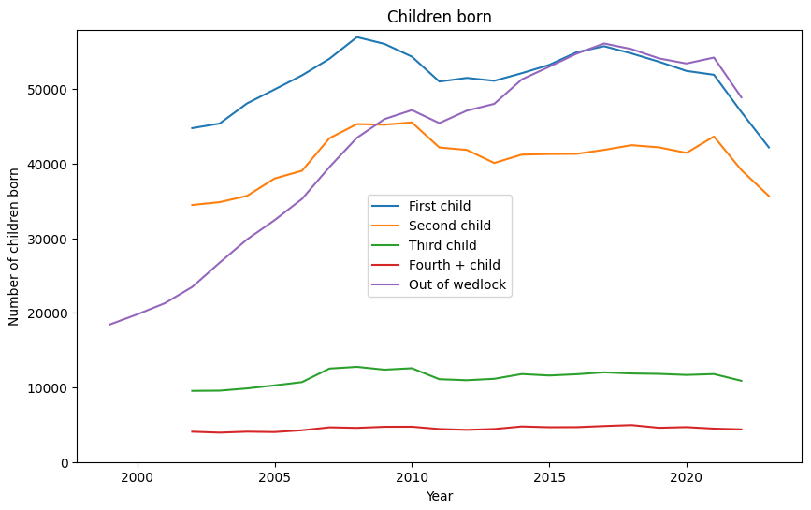
Children born

Slide 7
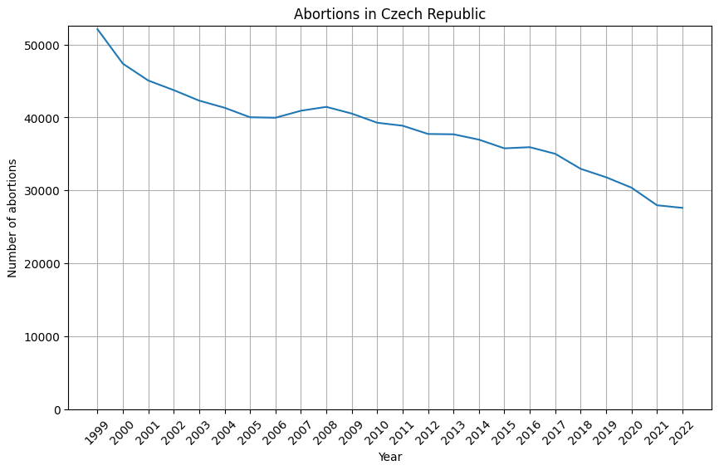
Abortions

